Slide 1
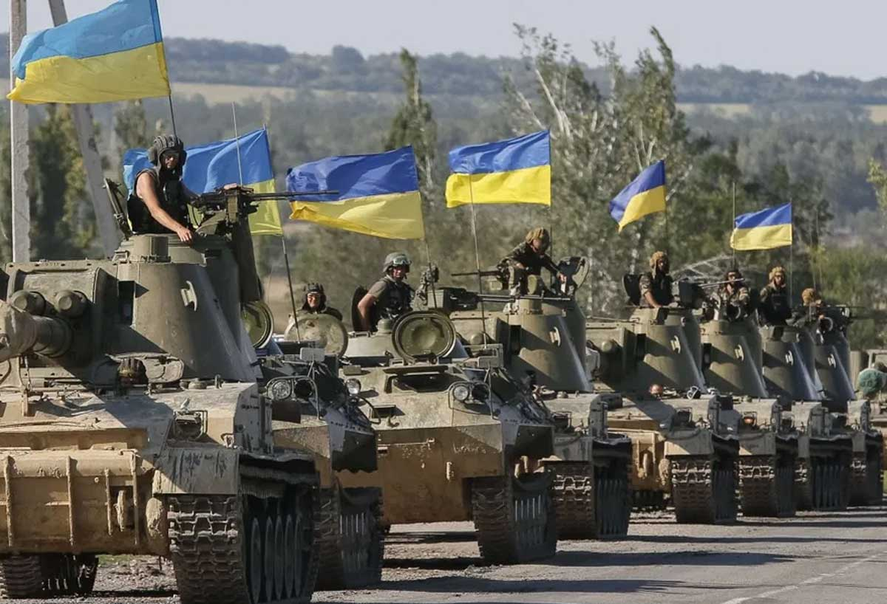

Text Analysis of Reddit Posts on the Russia-Ukraine War
Sam Blass
Metis NLP Module
20 April 2022
https://external-content.duckduckgo.com/iu/?u=https%3A%2F%2Fgeostrategicmedia.com%2Fwp-content%2Fuploads%2F2021%2F04%2Fdonbass-war.jpg&f=1&nofb=1

Slide 2
Objective
Topic Analysis
What are posters discussing?
Sentiment Analysis
How are posters feeling?
Gauge public sentiment directly from the people rather than through elected officials
Governments can use analysis to inform their response to the conflict

Slide 3
Data overview
Data overview
Subreddits
Mixture of political systems
Multiple regions
High GDPs
At least 1000 posts
Feb 23 - Apr 2
Post languages
English (84%)
Italian (4.4%)
French (3.6%)
German (1.7%)
…
Democracy
Hybrid regime
Authoritarian

Slide 4
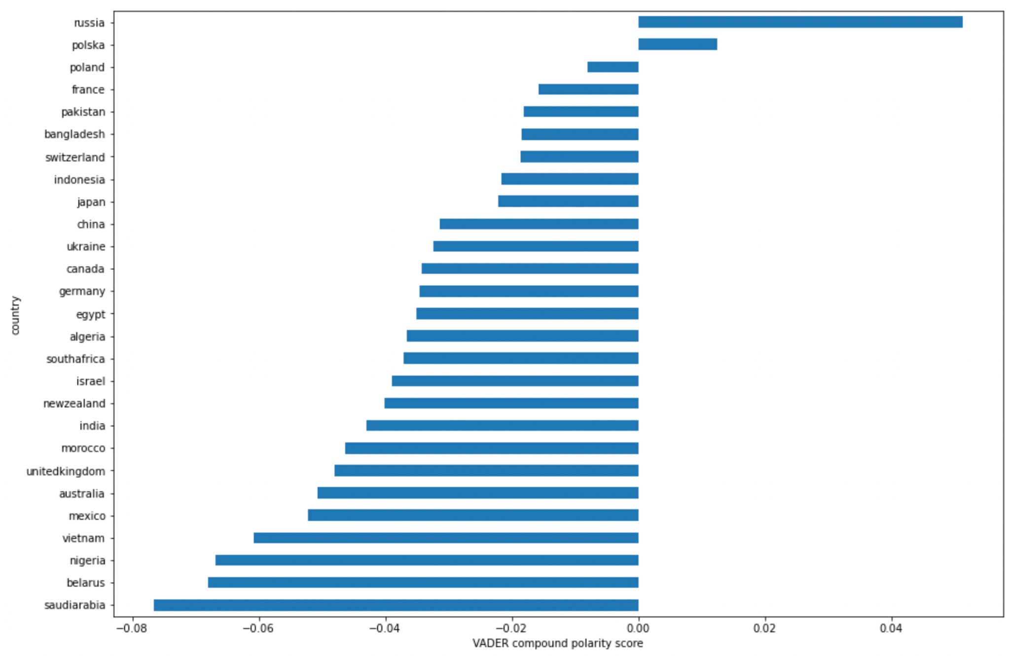

Sentiment Analysis
Does overall sentiment vary by country?
Saudi Arabia more negative than France?
Observations
Russia is positive
Nearly everyone else is negative
Parameters and tools
Data for 1000+ posts per country
VADER sentiment analysis
Belarus very negative
More granularity is necessary

Slide 5
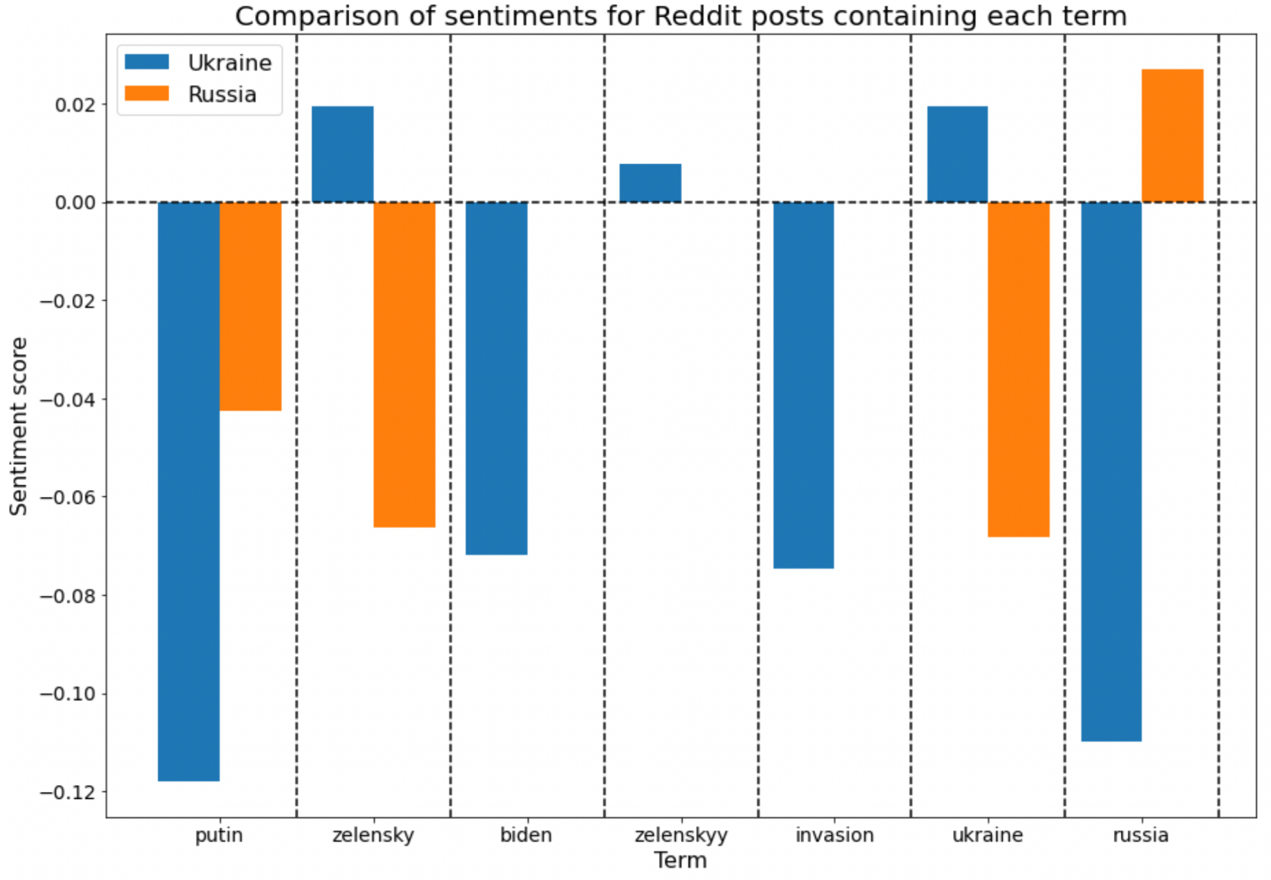
Sentiment Analysis
Differences between Ukraine and Russia
Sentiments differ by topic and country
Aligns with expected results
Notes
Most r/Ukraine posters probably not Ukrainian
r/Russia accused of government propaganda
* missing data indicates < 20 posts

Slide 6
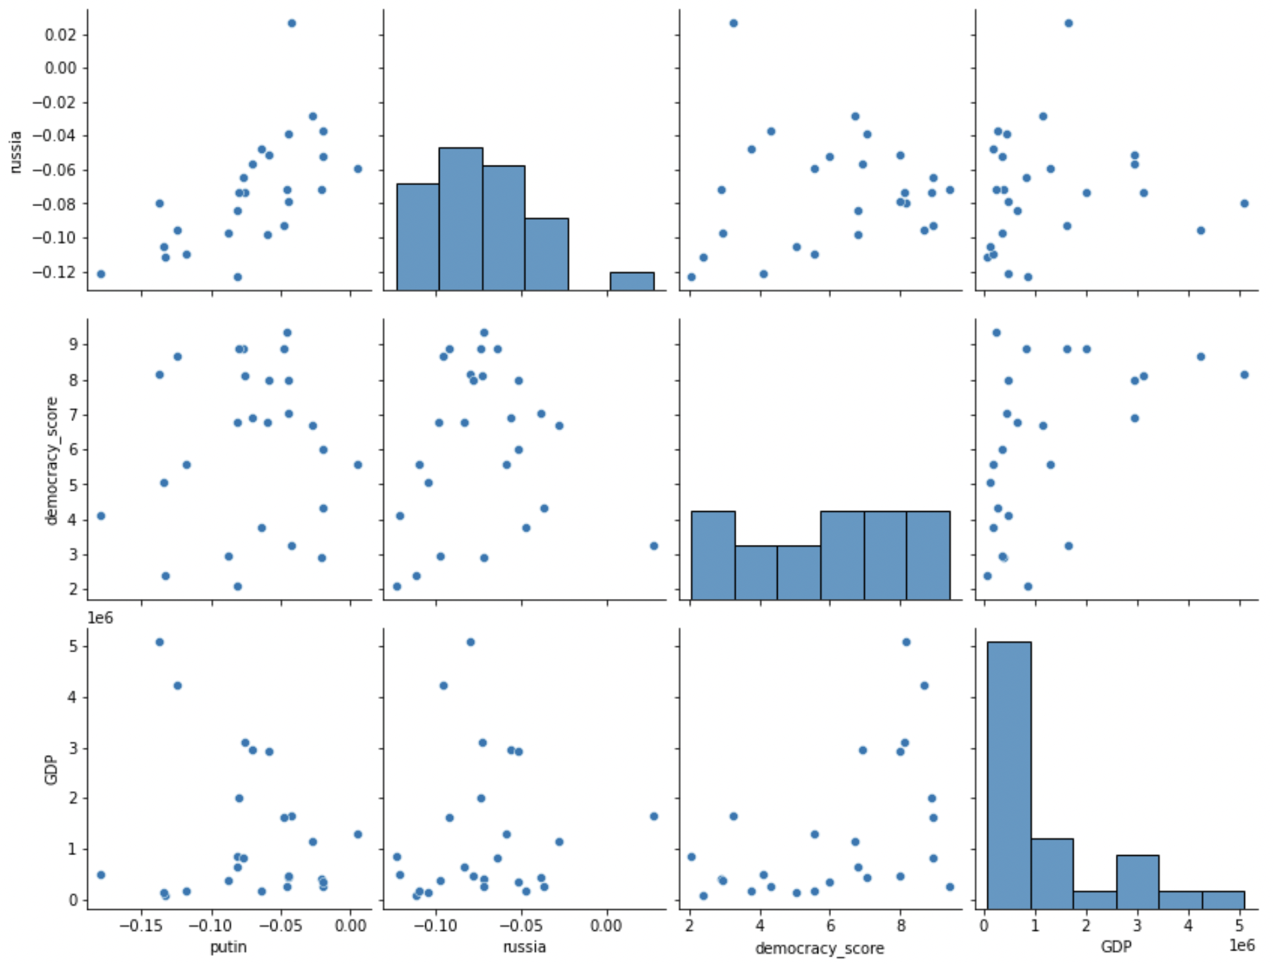
Sentiment analysis
No clear relationship between sentiment and GDP or democracy index
GDP vs. Putin/Russia
Expectation:
Negativity α GDP
Democracy Score vs. Putin/Russia
Expectation:
Negativity α DS

Slide 7
Topic Extraction
Ukraine subreddit
Topic # | Anchors | Prevalence | Topic | Top terms
1 | president, putin | 9.54% | Negative opinions of leaders | putin, president, fuck, trump, vladimir, biden
2 | nato | 3.48% | Discussion of NATO involvement | nato, join, member, attack, involve, alliance
3 | poland | 1.65% | Disinformation | poland, euvsdisinfo, nocat, interactive, ist, leben
4 | - | 31.22% | Automated messages | en, bot, kr, russia, sar, automatically
CorEx topic modeling
Extracts topics otherwise dominated by “Ukraine”, “Russia”
Topics reflect most important issues
Ukraine: broad disdain for leaders
Poland subreddit
Topic # | Anchors | Prevalence | Topic | Top terms
1 | president, putin | 6.58% | Negative opinions of leaders | putin, president, lukashenko, fuck, pro, trump
2 | nato | 5.22% | Discussion of NATO involvement | nato, member, attack, join, article, alliance
3 | poland | 11.25% | Sending allied jets to Ukraine | poland, ukraine, jet, lithuania, slovakia, valid,
4 | - | 32.12% | Border issues | polish, ukrainian, people, border, refugee, russian
Poland: Foreign military aid, refugee crisis

Slide 8
Topic Extraction
Belarus subreddit
Topic # | Anchors | Prevalence | Topic | Top terms
1 | president, putin | 9.15% | Disdain towards Lukashenko | putin, president, lukashenko, luka, vladimir, puppet
2 | nato | 2.37% | Favorable media coverage of NATO | nato, summary, extended, reputable, reuters, feedback
3 | poland | 13.15% | Border issues | poland, ukraine, russian, belarusian, ukrainian, force
4 | - | 20.99% | Protesting fascism | people, protest, country, fascist, year, like
CorEx topic modeling
Extracts topics otherwise dominated by “Ukraine”, “Russia”
Topics reflect most important issues
Protesting the Lukashenko government

Slide 9
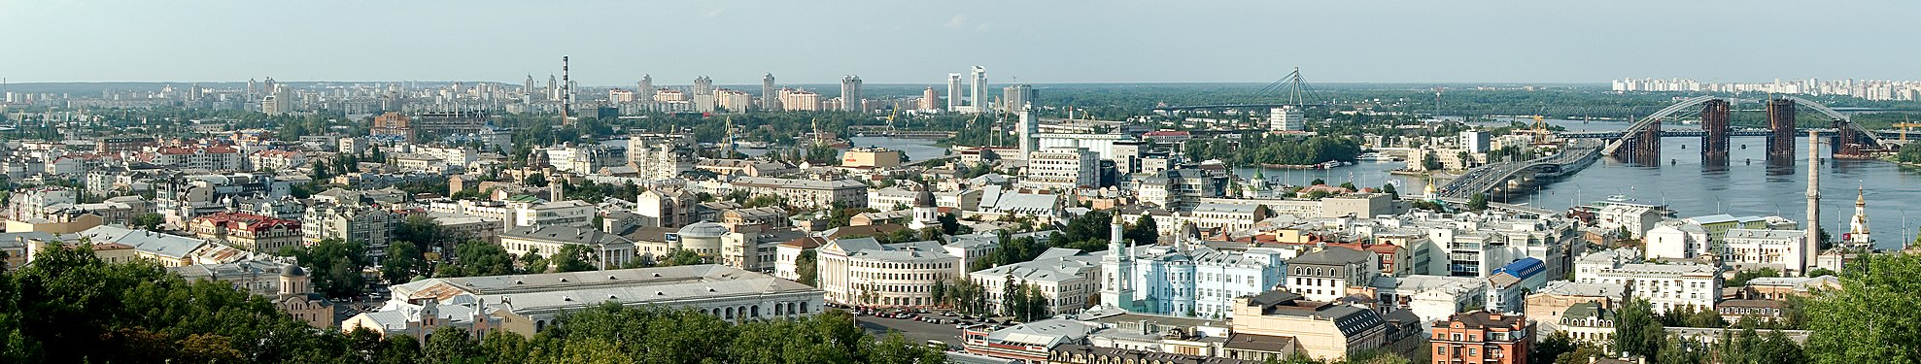
Conclusions
Country subreddits not necessarily representative of country’s citizens
Sentiment data only for English posts
No data on posters’ location
Authoritarian countries censor speech
Government propaganda on r/Russia
Topics reflect most important aspects of the conflict
Belarus: anti-Lukashenko
Poland: refugee crisis and foreign aid
No clear relationship between GDP and system of government
Governments may not be responding to the will of their citizens
https://upload.wikimedia.org/wikipedia/commons/thumb/2/2a/Panorama_of_Podil.jpg/1977px-Panorama_of_Podil.jpg

Slide 10
Thanks

Slide 11
Future work
Eliminate posts by the moderator
Explore more topic extraction with CorEx
Foreign language translations for non-English posts

Slide 12
Appendix

Slide 13
Pipeline
Raw data from Reddit
Remove numbers and URLs
Merge data sets with information from Wikipedia
Sentiment analysis by topic
Topic modeling

Slide 14
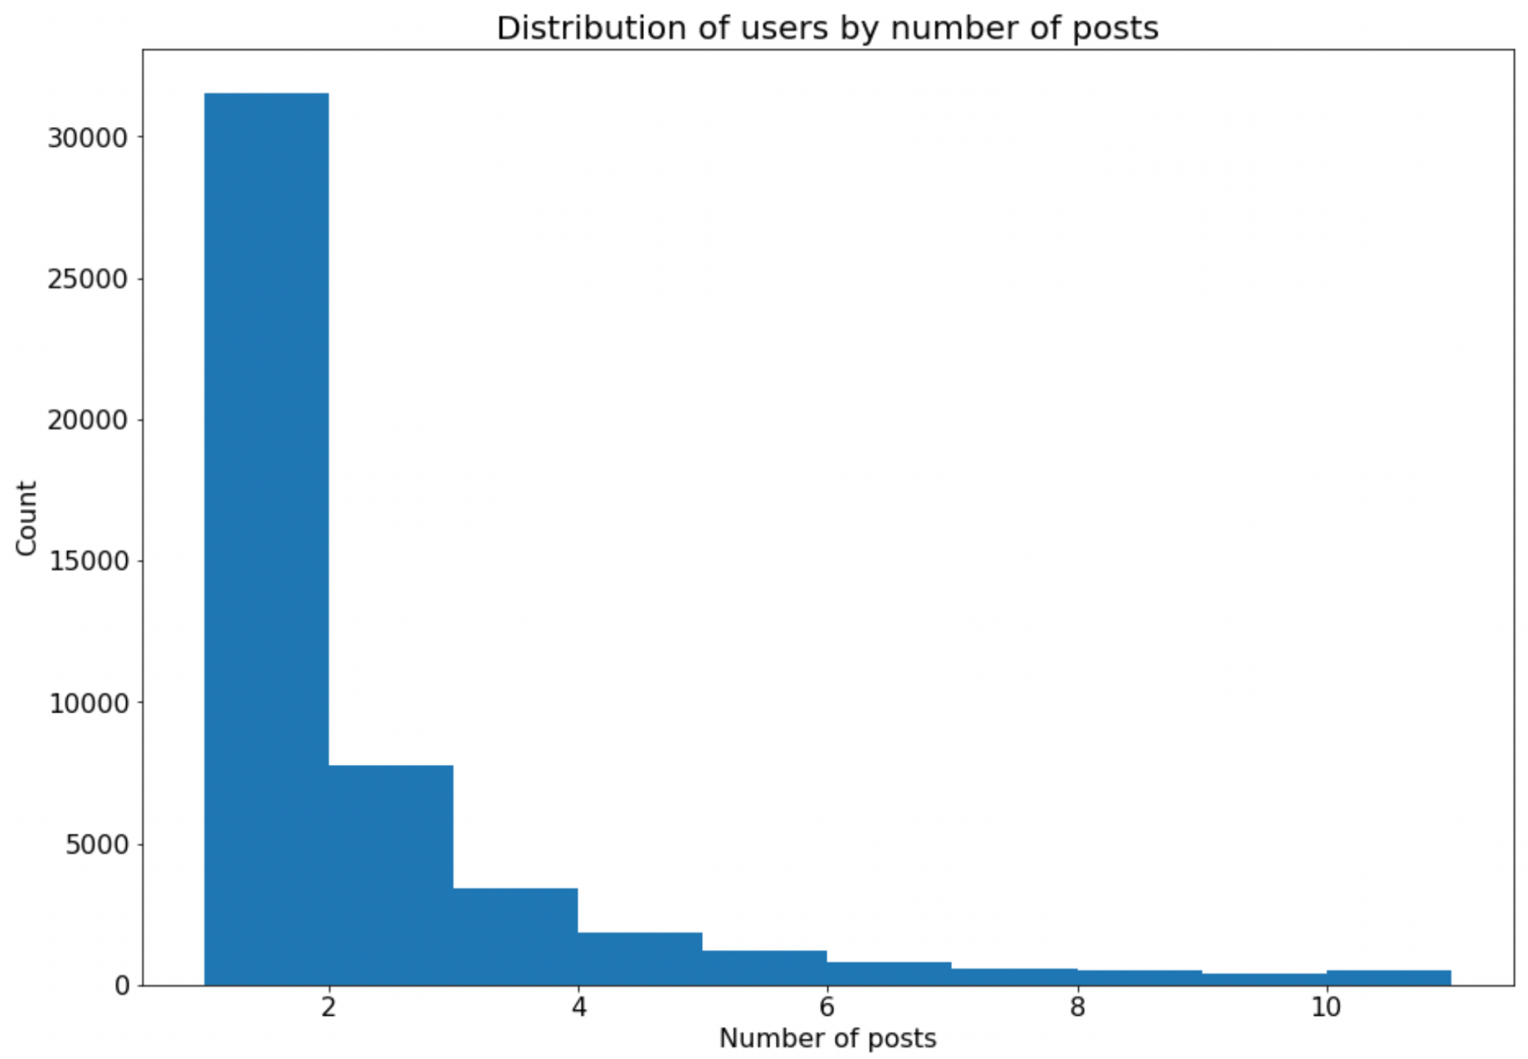

Data overview
Do any users dominate the conversation?
Features
Post text
Country
GDP
Democracy index
Abstained at UN
Processed text

Slide 15
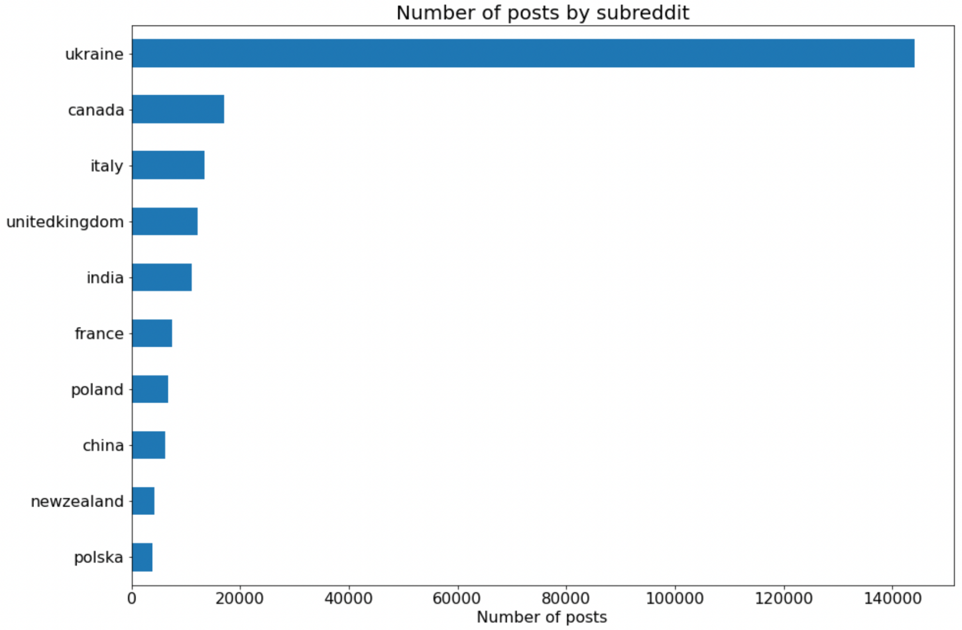
Data overview
Which countries discuss Ukraine the most?
Features
Post text
Country
GDP
Democracy index
Abstained at UN
Processed text

Slide 16
Topic Extraction
Saudi Arabia subreddit
Topic # | Anchors | Prevalence | Topic | Top terms
1 | president, putin | 8.88% |  | putin, president, wish, trump, government, mind
2 | nato | 7.10% | Expanding NATO | nato, join, expand, russia, way, death
3 | poland | 13.98% |  | poland, middle, british, east, time, queen
4 | - | 31.74% | Oil issues | sanction, agreement, increase, issue, include, oil,
CorEx topic modeling
Extracts topics otherwise dominated by “Ukraine”, “Russia”
Topics reflect most important issues
Country specific issues (oil for SA, missile defense for Israel)
Israel subreddit
Topic # | Anchors | Prevalence | Topic | Top terms
1 | president, putin | 8.88% |  | putin, president, bennett, vladimir, zelensky, bennet
2 | nato | 7.10% | Expanding NATO | nato, join, member, country, accept, membership
3 | poland | 13.98% | Humanitarian aid | poland, ukrainian, prime, ukraine, minister, humanitarian
4 | - | 31.74% | Missile defense | dome, iron, military, iran, israel, syria

